Slide 1

Worker Protection Standard (wps)
Laurie Rocco
WPS Coordinator
Pesticide Inspector
MDAR
617-438-0051
laurie.rocco@state.ma.us

Slide 2
Worker Protection Standard
Federal Rule passed in the 90’s
Rule to protect workers/handlers on Ag establishments
Pesticide Labels indicate that you must follow WPS, which then makes it LAW

Slide 3
WPS Changes Timeline
2015: Changes and updates made and passed
2016: Compliance assistance with growers
2017: Most of changes/updates are in effect
2018: All of the changes/updates are in effect

Slide 4
When does wps kick in???
If you employ people that work in the areas that are treated with pesticides = Workers
2. If you employ people that make pesticide applications for you = Handlers
AND
3. You see this on your pesticide labels…

Slide 5
YOU MUST comply if this is on the label
AGRICULTURAL USE REQUIREMENTS
Use this product only in accordance with its labeling and with the Worker Protection Standard, 40 CFR part 170. This Standard contains requirements for the protection of agricultural workers on farms, forests, nurseries, and greenhouses, and handlers of agricultural pesticides. It contains requirements for training, decontamination, notification, and emergency assistance. It also contains specific instructions and exceptions pertaining to the statements on this label about personal protective equipment (PPE) and restricted-entry interval. The requirements in this box only apply to uses of this product that are covered by the Worker Protection Standard. Do not enter or allow worker entry into treated areas during the restricted entry interval (REI) of 24 hours. PPE required for early entry to treated areas that is permitted under the Worker Protection Standard and that involves contact with anything that has been treated, such as plants, soil, or water, is:
• Coveralls
• Chemical-resistant gloves, Category F, such as barrier laminate, butyl
rubber, nitrile rubber, or Viton® ≥ 14 mils
• Shoes plus socks

Slide 6
The FIVE PARTS OF WPS
Training
Central Display Location/Area
Decontamination Site/Area
Notification
PPE
Training
PPE
Central Display Location
Notification
Decontainimation

Slide 7

Training
Must be a Certified Applicator or have attended the Train-The-Trainer course
(Keep copy of Train-The-Trainer class certificate on file)
Training MUST be done annually
Must keep Record of training for two (2) years:
Trainer’s name and qualifications
Date
Trainee’s name and signature
How training was conducted (DVD, flip chart)
TRAINING MUST BE DONE PRIOR TO ANY WORKER RELATED DUTIES!!!

Slide 8
TRAINING 2017/2018
2017
1.Provide training to ALL workers/handlers prior to them starting work
2.Be sure that trainer has Private Certification License OR has attended the train the trainer course
3. Use NEW training materials
4. Obtain a record of the training:
-Individual name & signature
-Trainer name & qualification
-Date of training
-Employer Name
-How training was given
Training video: https://vimeo.com/215241678

Slide 9


Central display location changes
New Safety Poster (2018)
Application records must include start and end time of application
SDS for all pesticides applied must be kept in a
location accessible to workers and handlers
(Central Location Display Area)
These SDS have to be kept for TWO (2) years

Slide 10

NEW Posting Requirements
Outside applications: choose to either notify verbally or by posting signs...UNLESS:
  Label states to do both
  If REI is 48 hours or more, MUST POST SIGNS
Indoor applications: Must post signs on entrances to treated areas UNLESS:
  REI of 4 hours or less, you can verbally notify
Post on the border of any Worker
housing within 100 feet of the treated area

Slide 11

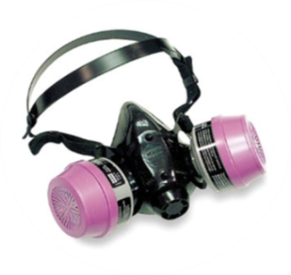
New Respirator Requirements
If your facility applies pesticides that REQUIRE respirators you must have:
Medical Evaluation
Respirator Training
Fit Test

Slide 12

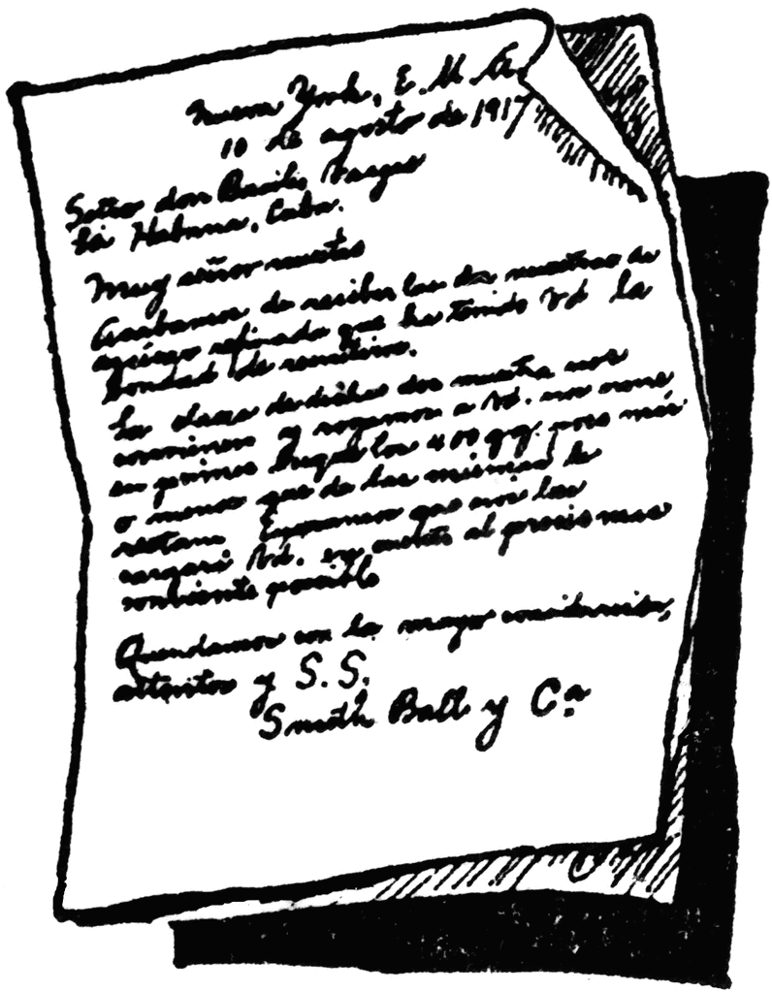
Medical EVALUATION
Needs to be done by Occupational Doctor
Only needs to be done one time:
Unless health changes with handler
Specific Medical Evaluation form filled out prior
Retain copy of medical clearance letter from the doctor indefinitely

Slide 13
Respirator training and Fit test
Must be done ANNUALLY
Use Respirator specified on label
Follow respirator checklist
Follow Fit Test Procedures 29 CFR 1910.134 Appendix A of the OSHA regs
Fit test and respirator training records must be kept for 2 (two) years

Slide 14


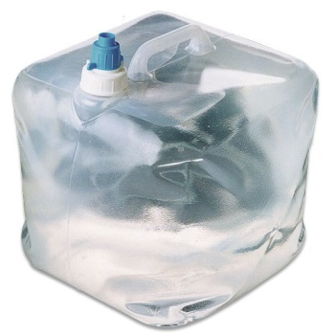
Decontamination Supplies
Running water, soap, single use towels, change of clothes, Eye wash
In addition to the old requirements:
Additional Safety Poster must be posted
Must have enough water for 15 min eyeflush
  0.4 gallons per minute for 15 minute or
  6 gallons at a gentle flow for 15 min
Must have enough water for:
  1 gallon per worker
  3 gallon per early entry worker
  3 gallon per handler

Slide 15

Application exclusion zone (AEZ)
NOT IN EFFECT UNTIL 2018!!!!
25-100 feet around the application equipment where no one is allowed in during the application
THIS IS A MOVING ZONE!!!!
Extends beyond the boundaries of the farm and beyond
farm employees
If applicator sees someone within the AEZ, applicator must SUSPEND application.
      100ft
      Aerially
      Airblast
      As a spray using a spray quality (droplet spectrum) of smaller than medium (diameter less than 294 microns)
      Fumigant, Smoke, Mist or Fog
      25ft
      sprayed at a height of greater than 12 inches from planting medium using a spray quality of medium or larger

Slide 16
Best Management practices
Read your labels!
Know your products!
Be aware of the weather conditions
Know basic bee biology
Open line of vision
Change the way you make applications
-Timing
-Application method

Slide 17
BEST MANAGEMENT PRACTICES cONTINUED
Contact abutters prior to application
Walk around property
Know your property lines
Provide any additional info if requested
Do not spray when windy or gusty
Use proper methods and equipment
Spray into the property
Spotter
Know your sensitive areas

Slide 18
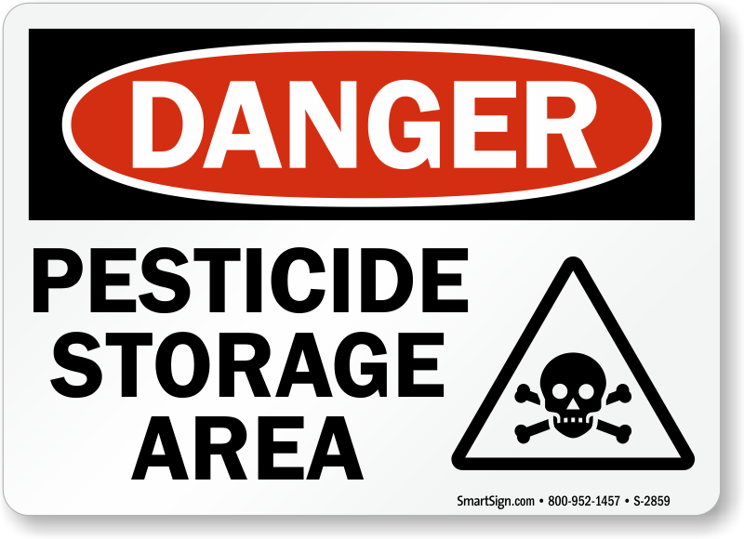
STORAGE
Solids over liquids
Secondary Containment
Metal vs. Wooden Shelves
Inventory Sheet
Labels and MSDS binder
Spill Kit
Ventilation

Slide 19
Questions???
Laurie Rocco
Worker Protection Standard Coordinator
Pesticide Inspector
MDAR
251 Causeway St
Suite 500
Boston, MA 02114
(617) 438-0051
laurie.rocco@state.ma.us

